Slide 1
Airbnb and COVID-19
Joel McMillin
DSC 530
11.20.2021

Slide 2


Hypothesis
Due to Covid-19, New York City Airbnb rental data from early 2020 through the present will show a sharp, initial decrease in usage and an increase in price due to limited availability and increased safety standards for both hosts and guests. This data will also show that as businesses and travel re-open throughout 2021, usage will sharply increase to pre-pandemic levels and prices will stabilize

Slide 3
Variables
Rental Type
Price
Number of Reviews per Month
Reviews per Month
Last Review

Slide 4
Room Type
The Room Type (room_type) variable in the New York City Airbnb data is broken down into 4 types. The types are the rental options available to consumers using Airbnb. The rate at which each is used over time could reflect changes in consumer behavior due to Covid-19, i.e., consumers may be less likely to want to share space with strangers who may increase their risk of contracting the virus.

Slide 5
Price
The Price (price) variable refers the price of the Airbnb rental properties, and my hypothesis posits that this variable will change in a way that reflects supply and demand for Airbnb properties leading up to, during and following the initial stages of the Covid-19 pandemic.

Slide 6
Number of Reviews
The Number of Reviews (num_revs) variable refers the total number of reviews for a given Airbnb rental property, and my hypothesis posits that this variable will also change in a way that reflects a sharp decrease during the initial stages of the pandemic. As businesses re-open and travel increases, this variable should also show increases approaching pre-pandemic levels in early 2021 as vaccines become widely available.

Slide 7
Last Review
The Last Review (last_review) variable refers the most recent month in which a given Airbnb rental property was reviewed by a customer, and my hypothesis posits that this variable will again change in a way that reflects a sharp decrease during the initial stages of the pandemic. As businesses re-open and travel increases, this variable should also show increases approaching pre-pandemic levels in early 2021 as vaccines become widely available.

Slide 8
Reviews per Month
The Reviews per Month (reviews_per_month) variable refers the mean number of reviews for a given Airbnb rental property, and my hypothesis posits yet again, that this variable will reflect a decrease due to the initial stages of the pandemic. Unlike the other variables, this one I expect to drop, and remain low, as it is an average over time which means month-to-month activity will not change at the same rate as variables that reflect active usage (last_review, for example).

Slide 9
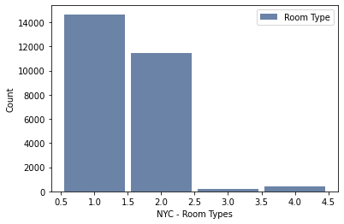
Room Type Summary
Entire Home/Apartment – this has been updated in the dataset as a ‘1’ Room Type (.5 - 1.5)
55% of total
Private Room – this has been updated in the dataset as a ‘2’ Room Type (1.5 – 2.5)
43% of total
Hotel Room – this has been updated in the dataset as a ‘3’ Room Type (2.5 – 3.5)
0.7% of total
Shared Room – this has been updated in the dataset as a ‘4’ Room Type (3.5 – 4.5)
1.3% of total
The overall preference is for Entire Home/Apartments, followed by Private Rooms
Hotel Rooms and Shared Rooms are much less frequent

Slide 10
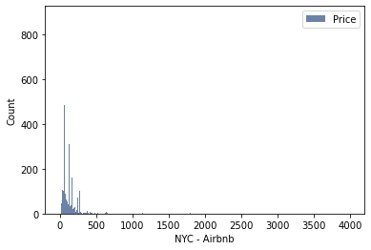
Price Summary
Mean Price: $151.60
Variance of Price: $28,301.97
Standard Deviation of Price: $168.23
Heavily right skewed
Spread: $10 to $4,000
Occurrences of outliers was not frequent, but the number of reviews at any outlying value was small. This is seen in the graph at right -
Airbnb pricing is skewed toward lower pricing with a higher count

Slide 11
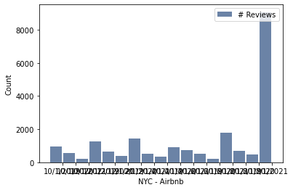
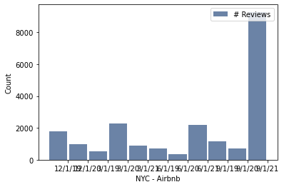
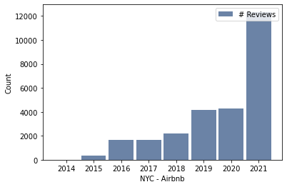
Number of Reviews Summary
Mean Number of Reviews: 27.3
Variance of Number of Reviews: 2762.8
Standard Deviation of Number of Reviews: 52.5
Heavily right skewed
Spread: 1 to 1006
The charts, left to right, show monthly, quarterly and yearly breakdowns
Note: Seasonality and a steady increase even through 2020, with a sharp increase in 2021

Slide 12
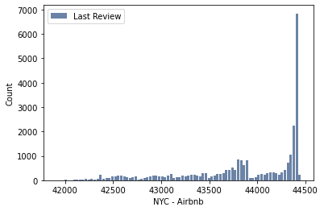
Last Review Summary
The mean for month of last review: February-March of 2020*
Variance for month of last review: 605 months
Standard Deviation for month of last review: Roughly 21 months
Last Reviews are heavily left skewed
Spread: January 2019 to September 2021
Shows a steady rise throughout 2019 followed by a sharp drop at the beginning of 2020 and the rate of reviews doesn't increase above pre-Covid levels until early 2021, and then increases dramatically in summer 2021
* Note – for visualization and analysis, months/years were converted to linear numeric data – 43500 is Feb 2019, 43800 is Dec 2019, 4400 is July 2020, 44500 is Sept 2021, as reference points

Slide 13
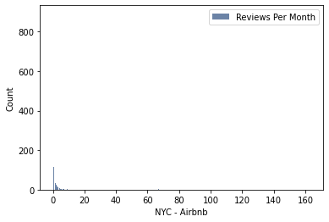
Reviews per Month Summary
Mean Reviews per Month: 1.5
Variance of Reviews per Month: 16.88
Standard Deviation of Reviews per Month: 4.1
Heavily right skewed
Spread: 0.02 to 163.19
Occurrences of outliers was not frequent, but the number of reviews at any outlying value was small. This is seen in the graph at right -

Slide 14
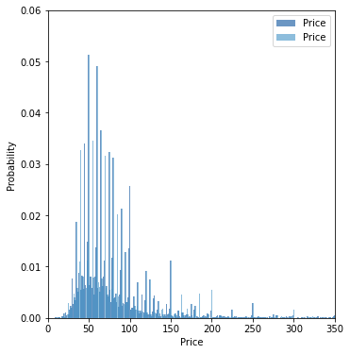
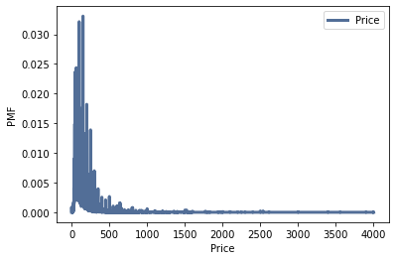
Scenario Comparison with PMF
Above Left – Price PMF for overall Pricing for NYC Airbnb properties
Above Right - Price PMF comparison of: Room Type 1 (Entire Home/Apartment) – Dark Blue Room Type 2 (Private Room) – Light Blue

Slide 15
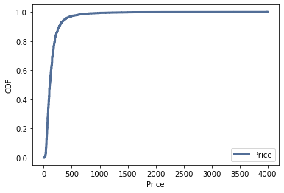
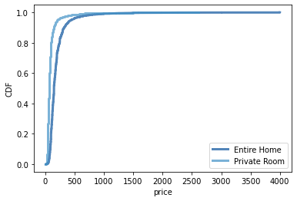
Price - CDF
The Price CDF shows the probability that the price for an Airbnb property will be below a given price
For example, there is a 47% probability that the price will be below $100/night, while at $400/night there's a 95% probability of finding an Airbnb property (of any type)

Slide 16
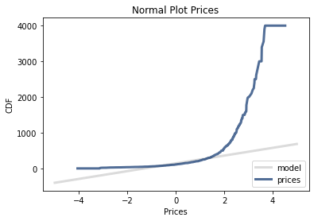
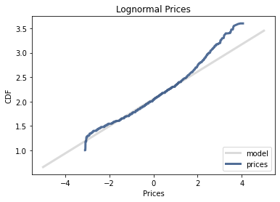
Analytical Distribution
On the Left is a normal distribution plot which does not fit most of the Airbnb Prices data
On the Right is a lognormal distribution plot which is a more accurate fit for the fluctuations seen in the Airbnb Prices data

Slide 17
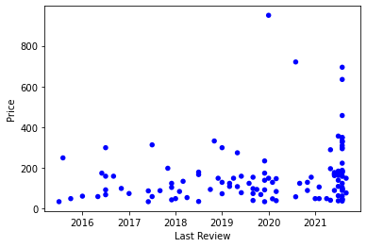
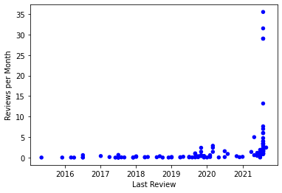
Scatter Plots
On the Left is a scatter plot showing correlation between Airbnb Price and the Last Review Date
Pearson’s Correlation is only 0.0789 so unlikely a significant correlation between the data points
With Last Reviews further back in time, pricing could reflect different supply and demand at that time, and there appears to be neither correlation nor a reason to assume causation
On the Right is a scatter plot showing correlation between Airbnb Reviews per Month and the Last Review Date
Spearman’s Correlation (Pearson’s would not run) is 0.735 which is slightly below the threshold of 0.75 which would indicate a strong correlation. There appears to be a correlation nonetheless even at face value. There should not be a causational relationship between these two variables

Slide 18
Hypothesis Testing
#Price –> Last Review
data = cleaned.price.values, cleaned.last_review.values
ht = CorrelationPermute(data)
pvalue = ht.PValue()
pvalue
#PValue - 0.0 ... unlikely by chance
#Price -> Number of Reviews
data = cleaned.price.values, cleaned.num_revs.values
ht = CorrelationPermute(data)
pvalue = ht.PValue()
pvalue
#PValue - 0.0 ... unlikely by chance
The two codes to the left allowed me to test the hypothesis that Price and Last Review are correlated, and that Price and Number of Reviews are correlated.
The correlations are unlikely to be by chance, and I posit that prices have changed with time to account for increased demand. Similarly, the growing number of reviews are in line with increased demand for these rental properties

Slide 19
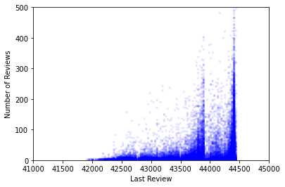
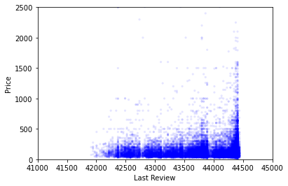
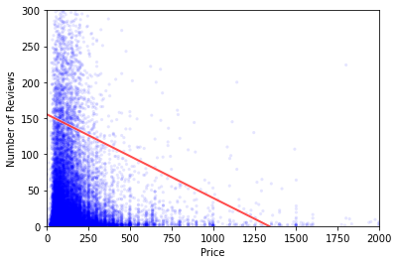
Regression Analysis
Above Left – Regression Analysis showing Number of Reviews over Last Review
This shows that at the end of 2019, many reviews were left on numerous properties, with a sharp decline in early 2020. Since that time, there has been a dramatic increase in reviews as usage of these properties increases beyond pre-pandemic levels
Slope - 2.81679 // Intercept - 43786.8 is between November and December 2019
Above Center – Regression Analysis showing Price over Last Review
This shows that at the end of 2019 there was a sharp drop in reviews, and then a new wave of properties enter the market throughout 2020-2021, and consumers are paying higher prices at higher rates than before the pandemic
Slope - 0.28388 // Intercept - 43832.7 is late January 2020
Above Right – Regression Analysis with line of fit for Number of Reviews over Price
This shows that as higher outlying prices are reached, there are far fewer reviews per rental property

Slide 20
Multiple Regression Analysis
formula = 'price ~ num_revs'
model = smf.ols(formula, data=df)
results = model.fit()
results.summary()
'''
OLS Regression Results
==============================================================================
Dep. Variable: price R-squared: 0.001
Model: OLS Adj. R-squared: 0.001
Method: Least Squares F-statistic: 39.57
Date: Sun, 14 Nov 2021 Prob (F-statistic): 3.22e-10
Time: 17:19:31 Log-Likelihood: -1.7473e+05
No. Observations: 26703 AIC: 3.495e+05
Df Residuals: 26701 BIC: 3.495e+05
Df Model: 1
Covariance Type: nonrobust
==============================================================================
coef std err t P>|t| [0.025 0.975]
------------------------------------------------------------------------------
Intercept 155.2726 1.183 131.283 0.000 152.954 157.591
num_revs -0.1162 0.018 -6.290 0.000 -0.152 -0.080
==============================================================================
Omnibus: 33715.928 Durbin-Watson: 1.853
Prob(Omnibus): 0.000 Jarque-Bera (JB): 8295244.688
Skew: 6.833 Prob(JB): 0.00
Kurtosis: 88.257 Cond. No. 73.6
'''
To the Left is multiple regression analysis of Price and Number of Reviews
The information to the left indicates there is no correlation between these two variables
While higher priced properties have lower numbers of reviews, it is not possible to use the number of ratings to effectively predict a property price

Slide 21
Conclusion
My Hypothesis was that New York City Airbnb rental data from early 2020 through the present will show a sharp, initial decrease in usage and an increase in price due to limited availability and increased safety standards for both hosts and guests. This data will also show that as businesses and travel re-open throughout 2021, usage will sharply increase to pre-pandemic levels and prices will stabilize.
What I found was that while there was a dramatic decrease in Airbnb rental usage at the beginning of 2020, roughly January-March, this began to increase again by late 2020. Not only did Airbnb usage increase back to pre-pandemic levels by mid-2021, it greatly exceeded pre-pandemic usage, if we are able to use number of reviews and most recent reviews as indicators of monthly usage

Slide 22
References
Airbnb Help Center. Help Center. https://www.airbnb.com/help/article/2839/health-and-safety- requirements-for-airbnb-stays
Get the data. Inside Airbnb. http://insideairbnb.com/get-the-data.html

